Slide 1
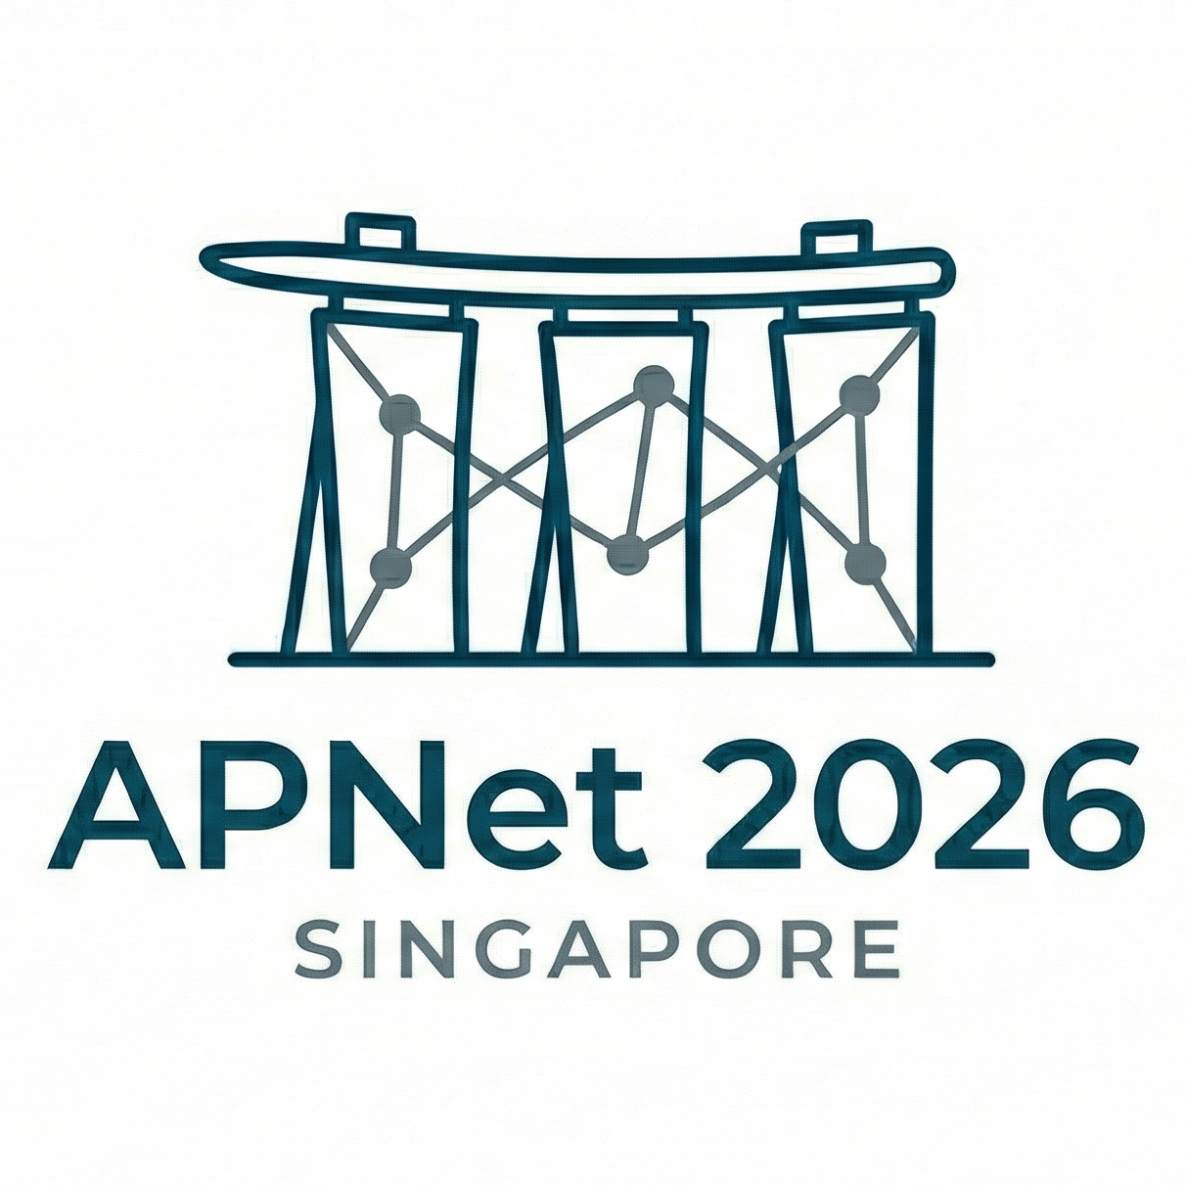
HyLink
Harnessing PCIe and Dedicated Interconnects for Efficient Collective Communication
Yuezheng Liu, Menghao Zhang, Xuebin Song, Juner Shen, Chunming Hu, Xudong Liu
Beihang University
Notes:
Good morning everyone, I’m Yuezheng Liu, from Beihang University. I’m happy to share our recent work…

Slide 2
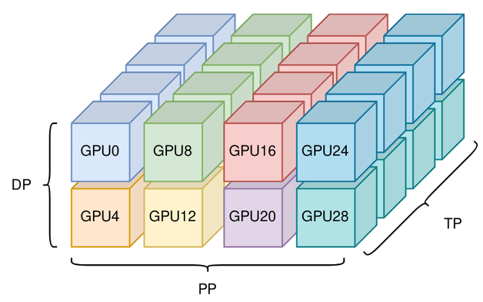
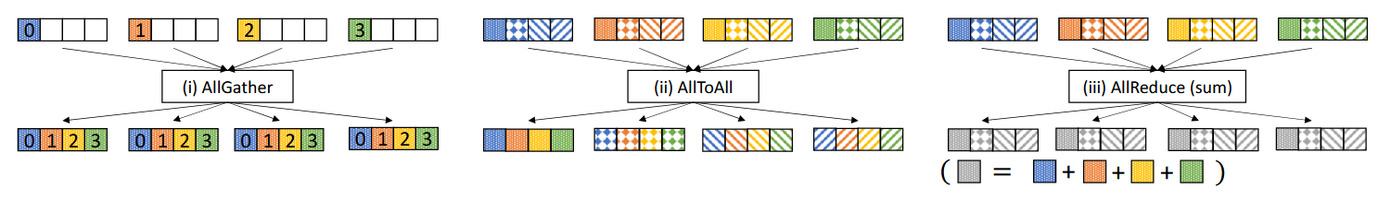
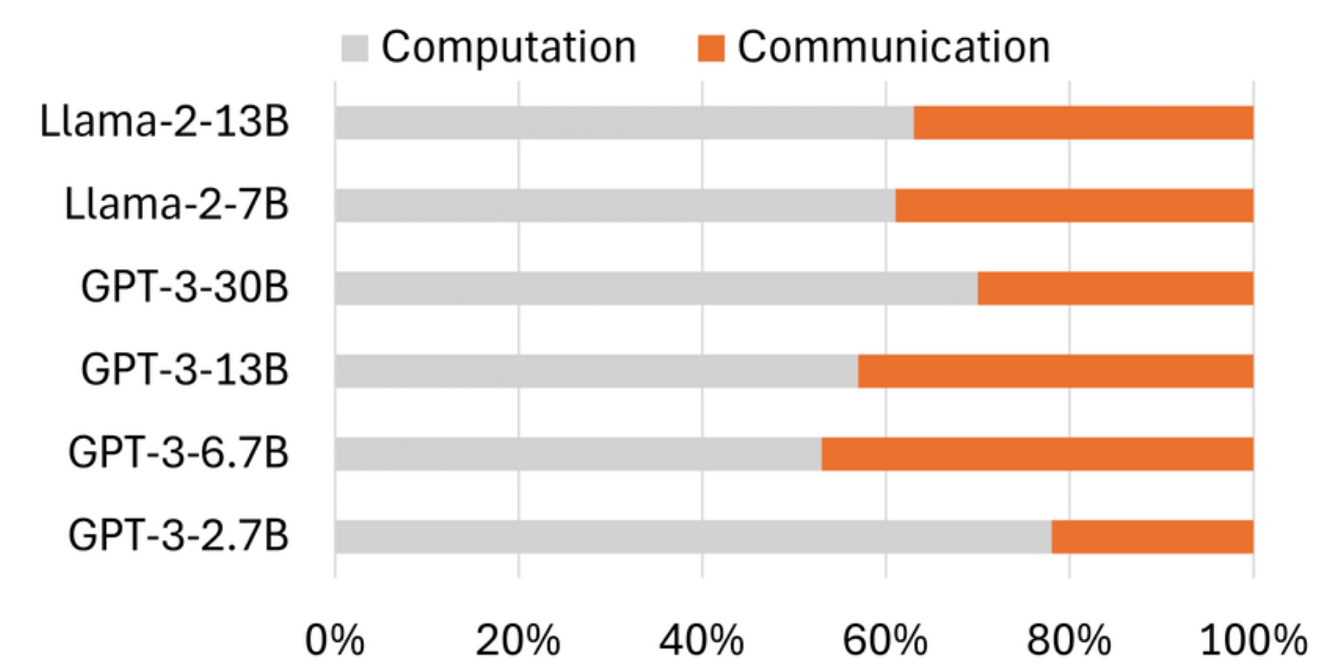
Collective Communication in LLMs
LLM parameter scale continues to grow rapidly, requiring increasingly large-scale training clusters.
Parallelism (like DP / PP / TP) needs frequent synchronization of huge data volumes via collective communication.
3D parallelism: DP × PP × TP
Optimizing collective communication is essential for LLM training
Core collectives: AllGather, AllToAll, AllReduce
Much of this communication (e.g., TP, EP) is exposed on the critical path, and not overlappable with compute.
Studies on real LLM training report TP communication alone can reach 22%–47% of iteration time^{[1]}.
TP comm. in LLM training
[1] Wang G, Zhang C, Shen Z, et al. Domino: Eliminating Communication in LLM Training via Generic Tensor Slicing and Overlapping. arXiv(2024-09).
Notes:
In recent years, …
To support large-scale distributed training, several parallel mechanism are applied, such as Data Parallelism, Pipeline Parallelism and Tensor Paralleism, which …
Some of this communication (such as Data Parallelism) can overlap with computation, but …

Slide 3
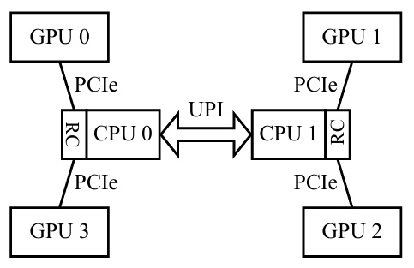
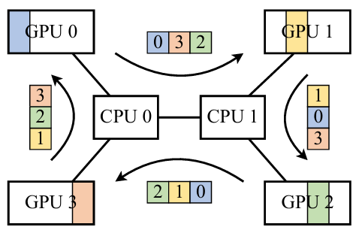
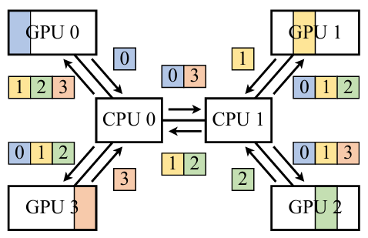
Observation 1: PCIe Collectives Topo Mismatch
Many cost-efficient machines adopt a pure PCIe topology without dedicated link.
Existing CCLs (e.g. NCCL, MSCCL) model this PCIe topology as a flat GPU-to-GPU network, which mismatches the underlying CPU-centric PCIe tree topology.
They treats the CPU as a passive relay, causing redundant PCIe traffic.
Example: 2 NUMA 4 GPU AllGather, Ring Algorithm vs. Theoretical.
3x Each Direct
2x Each Direct
3x Upload, 3x Download
1x Upload, 3x Download
2 NUMA 4 GPU
Pure PCIe topology
Ring Algorithm
(Flat GPU-to-GPU modeling)
Theoretical
(CPU-aware modeling)
Notes:
To optimize collective communication, we have the following two observations.
First, we find current CCL has a topology mismatch for PCIe machine. It affects many cost-efficient machines which adopt a pure PCIe topology without dedicated link.
…
And here is an example of two NUMA four GPU AllGather.
For NCCL’s Ring Algorithm, a four-rank AllGather need 3 steps, so each GPU upload and download three chunks from peer GPU. For inter-numa link, it also transfers 3 chunks each direction.
But theoretically, for AllGather, a rank only need to upload its own chunk, and inter-numa link only need to transfer data of peer NUMA’s ranks, which is two here instead of three.

Slide 4
Observation 2: Vendor CCLs Leave PCIe Idle
Current CCLs ignore hybrid links: when a dedicated link exists, they route all traffic through it and simply ignore the PCIe path.
For machines have dedicated link (e.g. NVLink, xGMI or HCCS), the idle PCIe link can add 10–32% extra bandwidth across hardware vendors and generations.
PCIe is vulnerable to interference (checkpointing, data loading, monitoring….), so its available bandwidth varies at runtime — runtime adaptation is needed.
Accelerator | Dedicated Link Bw. | PCIe Bw. | PCIe / Dedicated Ratio
NVIDIA V100 32G SXM | 300 GB/s | 32 GB/s | 10.7%
NVIDIA A100 80G SXM | 600 GB/s | 64 GB/s | 10.7%
NVIDIA H100 SXM | 900 GB/s | 128 GB/s | 14.2%
NVIDIA H800 SXM | 400 GB/s | 128 GB/s | 32.0%
AMD Instinct MI300X | 896 GB/s | 128 GB/s | 14.3%
Huawei Ascend 910B | 392 GB/s | 64 GB/s | 16.3%
Notes:
The other observation is, when the machine equip with dedicated link, vendor CCLs often leave PCIe link idle. When a …
However, for machines that have dedicated link, we find the idle PCIe link …
Further more, PCIe is vulnerable to interference. For example, checkpointing, data loading, monitoring… all of them consume the PCIe bandwidth. So available PCIe bandwidth varies at runtime, and runtime adaption is needed.

Slide 5
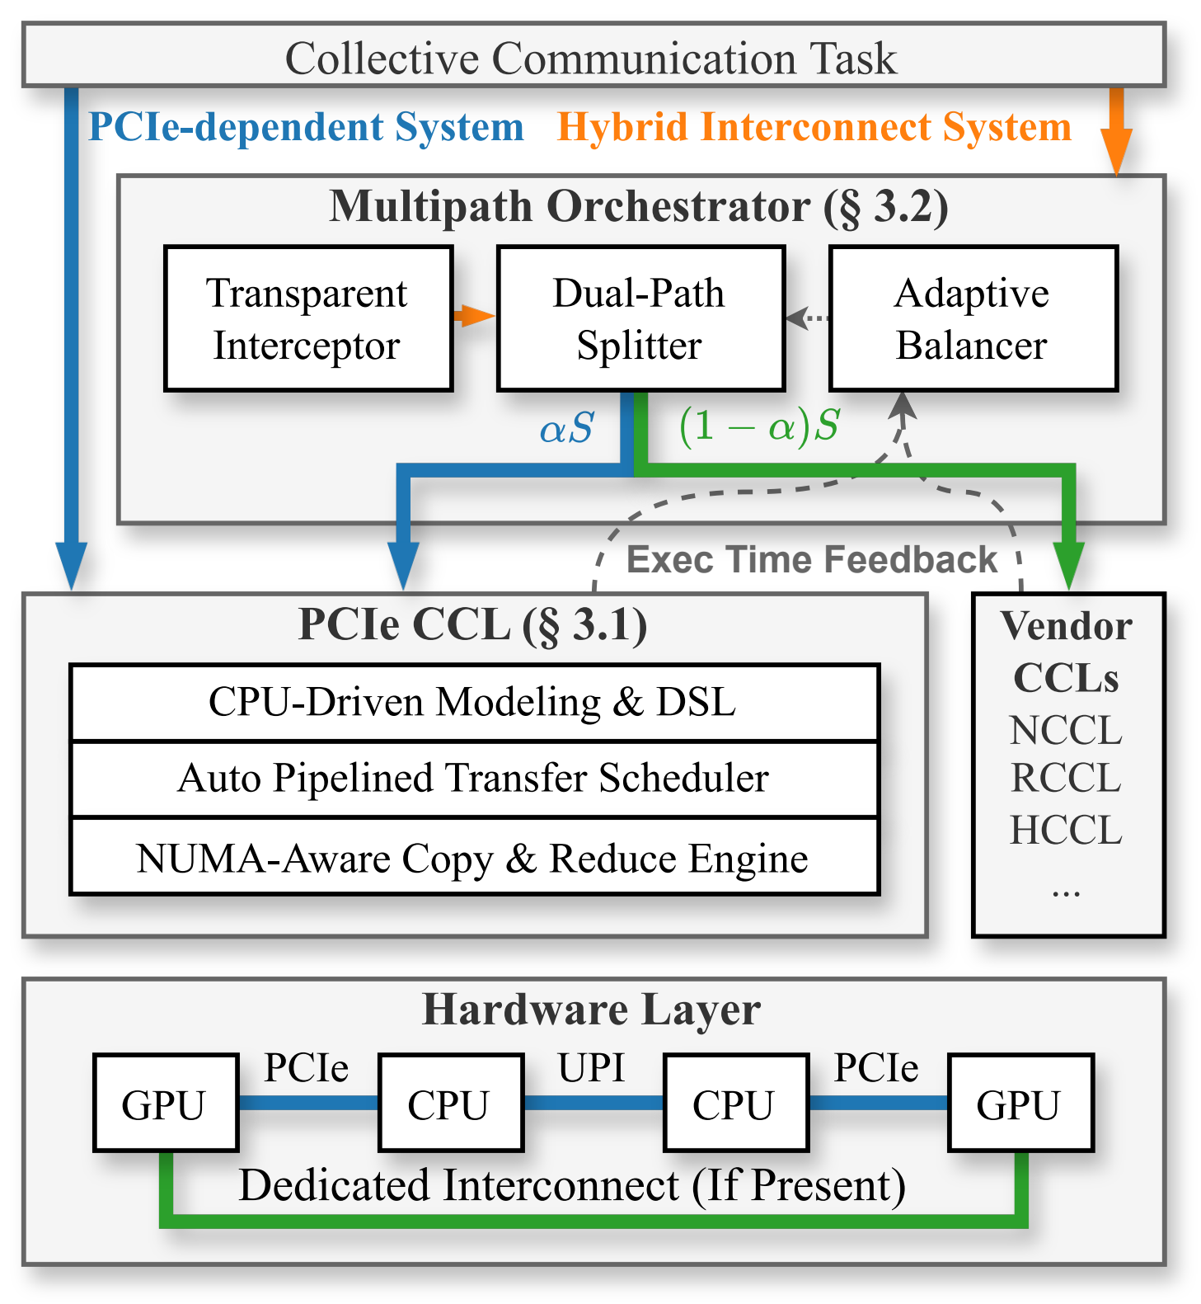
HyLink — Design Overview
PCIe CCL — models the PCIe hierarchy natively, with the CPU as an active router & compute node. (Observation 1)
Multipath Orchestrator — split collectives and make them run on both dedicated link and PCIe link efficiently. (Observation 2)
Workflow:
  LD_PRELOAD intercepts collective calls
  split α → PCIe, 1−α → dedicated, run concurrently on independent streams (for pure PCIe machine, α = 1)
  runtime feedback adjusts α by exec time
Notes:
Based on the two observations, we propose HyLink, a two-layer collective framework to make better use of PCIe bandwidth.
For observation 1, the PCIe topology mismatch, we propose PCIe CCL, which …
For observation 2, aggregating PCIe bandwidth in dedicated-link machine, we propose Multipath Orchestrator, which …
When a collective task arrives, it will be intercepted by our library, and if the machine doesn’t have dedicated link, the task will be sent to PCIe CCL directly.
If the machine has dedicated link, the collective will be split to two path according to a split ratio alpha, and send the two tasks to PCIe CCL and Vendor CCL(such as NCCL).
The multipath orchestrator will record execution time of both tasks, and use a runtime feedback mechanism to adjust the split ratio alpha.

Slide 6
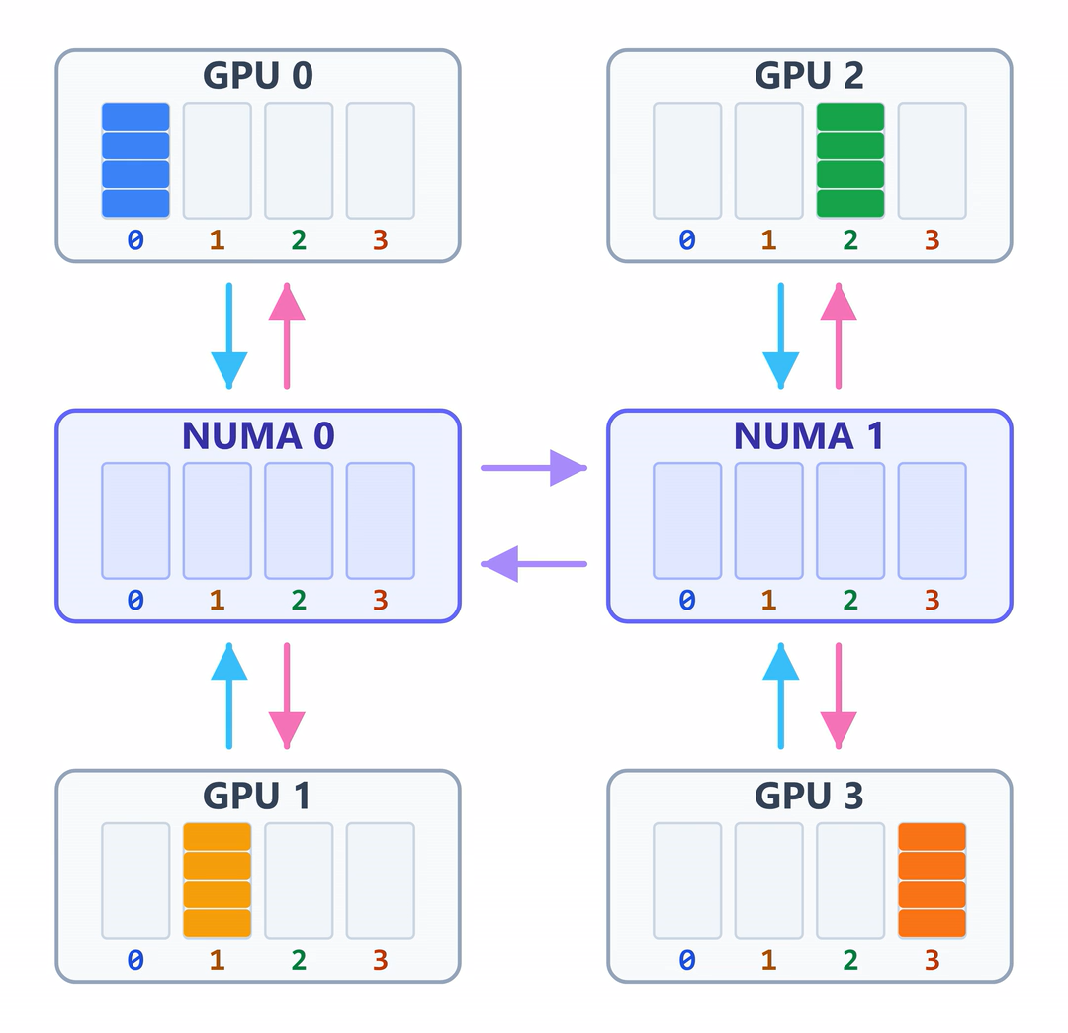
Component #1: PCIe CCL
CPU-Aware Collective DSL:
  D2D — place each rank's own contribution directly in its receive buffer.
  D2H / H2D — move chunks between a GPU and its local host memory.
  H2H / REDUCE — route chunks across NUMA nodes or reduce them in host memory.
# AllGather | Rank 0 | NUMA 0
# Keep and upload the local chunk
D2H gpu[0].send -> host[0].chunk[0]
D2D gpu[0].send -> gpu[0].recv[0]
# Stage remote chunks locally
H2H host[1].chunk[2] -> host[0].chunk[2]
H2H host[1].chunk[3] -> host[0].chunk[3]
# Fill from local host memory
H2D host[0].chunk[1] -> gpu[0].recv[1]
H2D host[0].chunk[2] -> gpu[0].recv[2]
H2D host[0].chunk[3] -> gpu[0].recv[3]
Auto-pipelined transfer engine
  Fine-grained overlap — keeps the DSL at chunk level but move data in subchunk granularity, allowing D2H, H2D, and host-side stages to overlap in a full-duplex pipeline.
  Causal scheduling — progress counters enforce per-subchunk D2H → host stage (H2H / REDUCE) → H2D dependencies.
How to choose the chunk granularity?
  Too few chunks — insufficient pipeline depth leaves large bubbles.
  Too many chunks — creates too many instructions and makes the algorithm harder to write.
DSL for 2 NUMA 4 Rank AllGather
Demo for 2 NUMA 4 Rank AllGather
Notes:
Now we dive into the two components. The first is PCIe CCL.
To include CPU into collective communication model, we propose a CPU-Aware collective Domain Specific Language.
It illustrates how data flows in the PCIe topology in a chunk granularity.
The DSL includes three types of instruction.
First is D2D, which can place each rank’s own contribution in its receive buffer in the same rank.
Then is D2H and H2D, which moves …
The last type is H2H / Reduce, which …
The question is, …
To address this dilemma, we propose an Auto-pipelined transfer engine.
The right hand side demonstrate the subchunk dataflow of a PCIe AllGather.
It keeps … And it computes the causal scheduling, and enforce the … dependencies. That means a subchunk can be transferred to next stage only after it arrives.

Slide 7
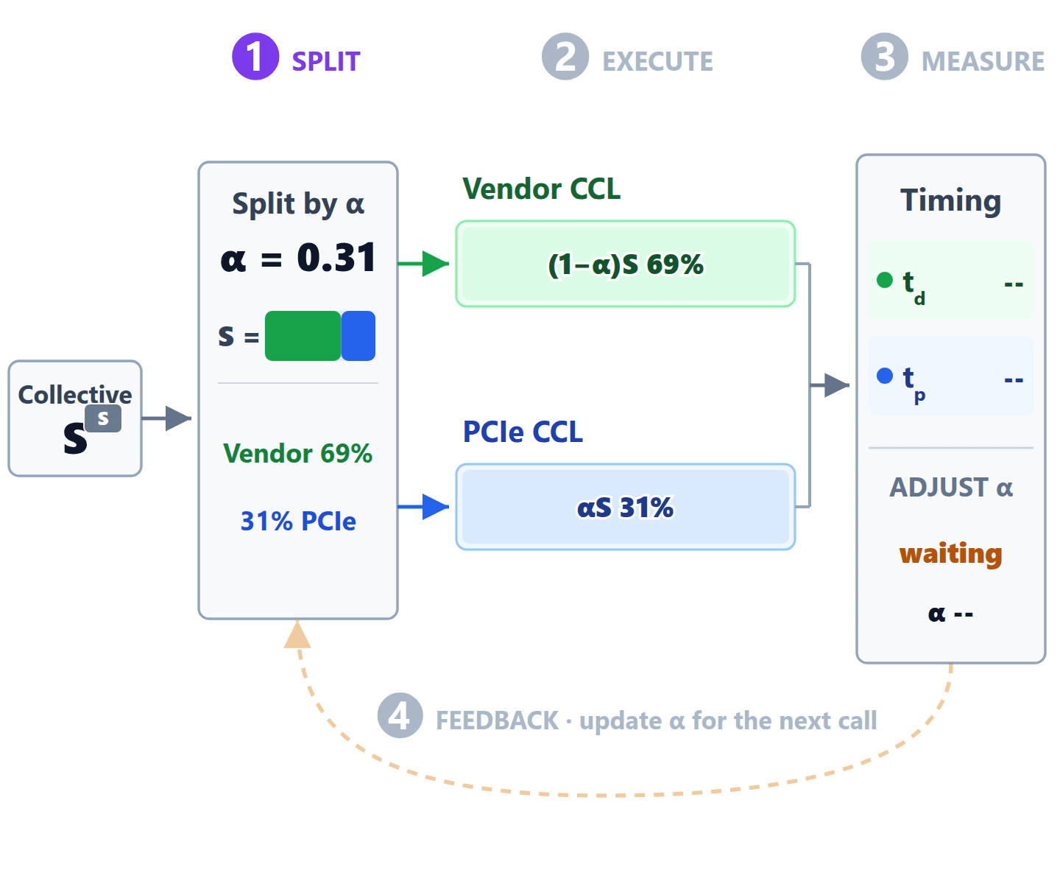
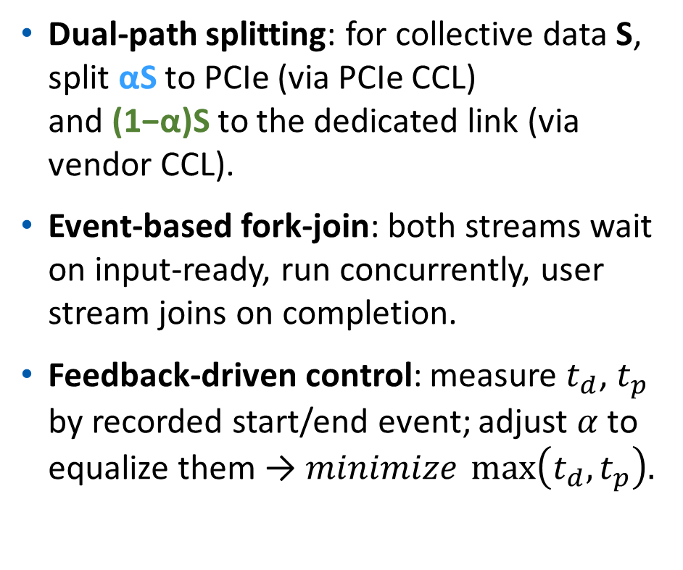
Component #2: Multipath Orchestrator
Dual-path splitting: for collective data S, split αS to PCIe (via PCIe CCL) and (1−α)S to the dedicated link (via vendor CCL).
Event-based fork-join: both streams wait on input-ready, run concurrently, user stream joins on completion.
Feedback-driven control: measure $t_{d}$, $t_{p}$ by recorded start/end event; adjust $α$ to equalize them → $minimize \max\left(t_{d},t_{p}\right).$
Notes:
The second component is Multipath Orchestrator. It enable the multipath collective communication on both dedicated link and PCIe link.
It first split input and output logical chunk into two part, and send them to PCIe CCL and vendor CCL.
To guarantee the correctness of stream semantic, we use streamWaitEvent API to make PCIe CCL and Vendor CCL stream wait on user stream, and make user stream wait on these two stream’s completion.
After a collective communication completes, Multipath Orchestrator measure the two path’s execution time and adjust split ratio alpha.
For example when PCIe link is occupied, the ratio for PCIe task will be decreased for next iteration. When PCIe link become Idle again, the ratio will increase back.

Slide 8
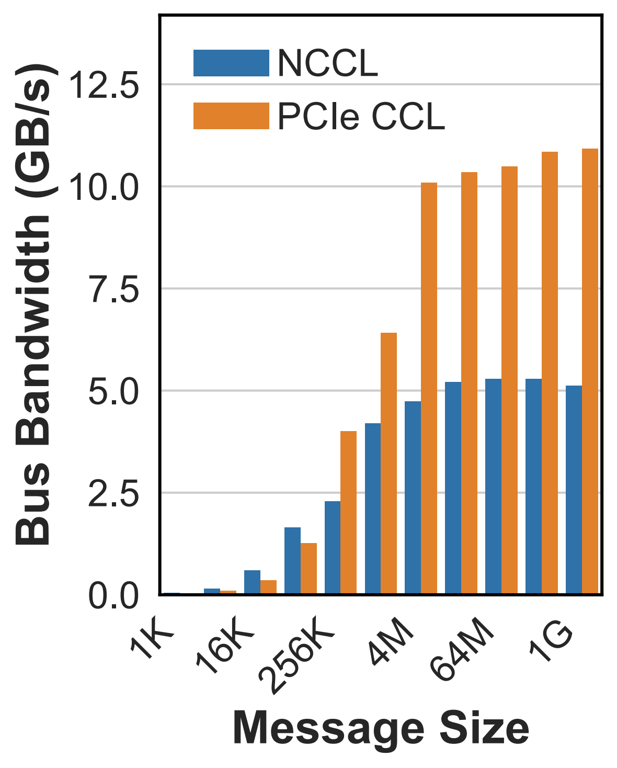
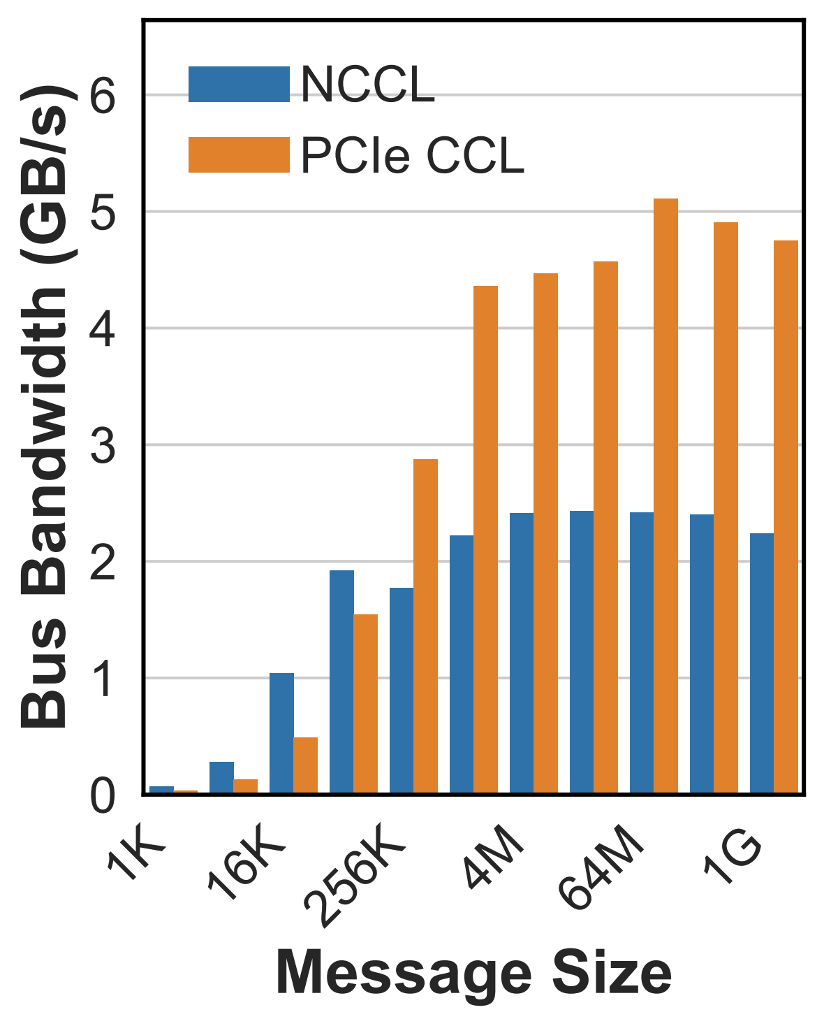
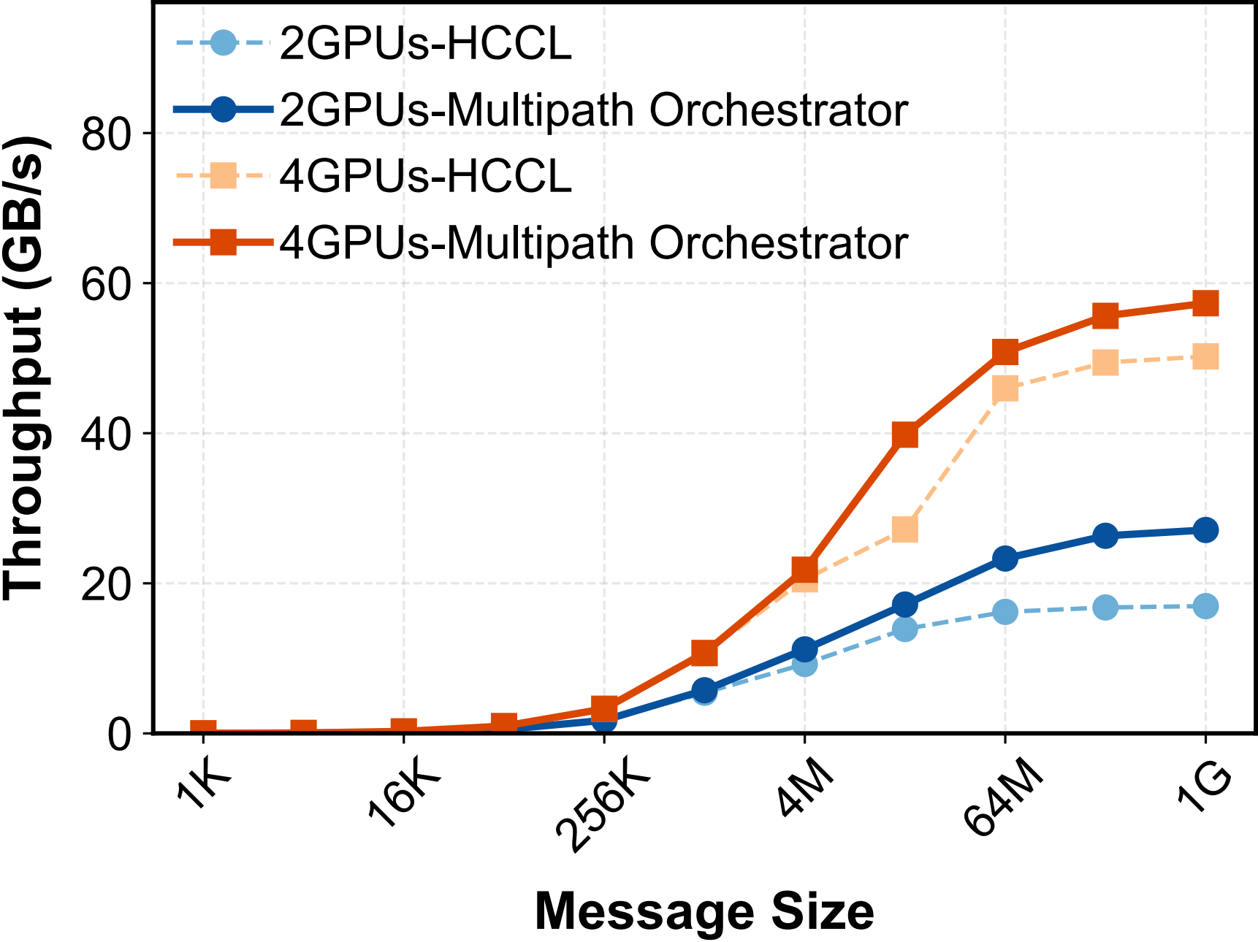
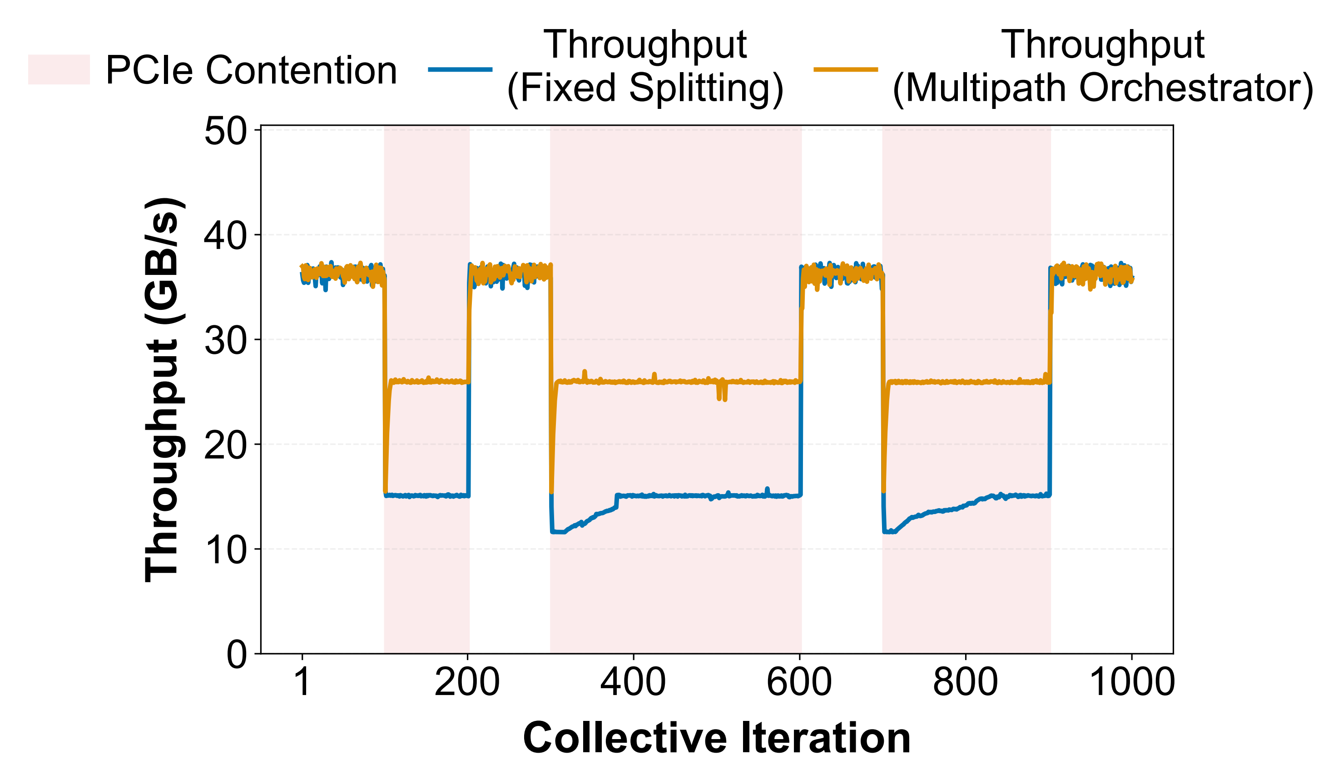
Implementation & Evaluation
Implementation:
  ~6,200 lines of C++ code for PCIe CCL.
  ~4,600 lines of C++ code for Multipath Orchestrator.
  Open source at GitHub [1].
Evaluation:
  For PCIe-only machine (RTX 3090), PCIe CCL improve collective bandwidth by up to 2.28x (vs. NCCL).
  For Dedicated-link machine (Ascend 910B), HyLink improve collective bandwidth by up to 1.4x (vs. HCCL on HCCS alone).
  HyLink improve throughput by up to 66% under PCIe interference (vs. static split ratio).
PCIe CCL - AllGather
PCIe CCL - AllReduce
Multipath Orchestrator
Resilience to Interference
[1] https://github.com/Networked-System-and-Security-Group/HyLink
Notes:
We implement HyLink as two library. About sixty-two hundred lines of code for PCIe CCL and forty-six hundred lines of code for Multipath orchestrator. The code is currently available on GitHub.
We evaluate HyLink on two types of machine.
…
We also evaluate HyLink on simulated PCIe Interference, and HyLink can improve throughput up to 66% compared to a static split ratio.

Slide 9
Conclusion & Future Work
PCIe bandwidth in GPU clusters is underutilized for collective communication.
HyLink unlocks it via a two-layer co-design:
  PCIe CCL — hierarchical modeling + CPU as active router.
  → up to 2.28× NCCL on PCIe-only machine.
  Multipath Orchestrator — adaptive dual-path splitting with runtime feedback.
  → 1.4×HCCL hybrid, 66% over static under interference.
Future Work
  Topology-aware DSL synthesis — PCIe layouts differ but share a tree structure, so one synthesizer may generate the best DSL for any platform.
  Intra-iteration work stealing — once the dedicated path finishes, it steals the PCIe path's residual chunks, cutting re-balancing from several iterations to within one.
Notes:
To summarize: PCIe bandwidth in GPU clusters is currently underutilized for collective communication, and HyLink unlocks it through a two-layer co-design.
PCIe CCL model CPU as an active router and reducer to eliminate PCIe redundant traffic.
And Multipath orchestrator aggregate PCIe and Dedicated link to execute collective communication.
And there are some directions for Future work:
…

Slide 10
Thank You!
HyLink
Harnessing PCIe and Dedicated Interconnects for Efficient Collective Communication
Source Code:
https://github.com/Networked-System-and-Security-Group/HyLink
Contact me:
Yuezheng Liu (he/him)
Master’s Student, Beihang University
liuyuezheng@buaa.edu.cn
Notes:
Thank you for listening. I’m happy to answer questions here or by email.

Slide 11
Things You May Concern…
For the PCIe path, why route D2H → H2D instead of GPU-to-GPU P2P?
  When a dedicated link exists, the driver routes all GPU P2P through it, and the PCIe P2P path is disabled and out of user’s control.
  The auto-pipeline overlaps D2H + H2D full-duplex, so host relay saturates PCIe all the same, and additionally lets the CPU reduce & multicast, which P2P cannot.
Does HyLink scale to multi-node clusters?
  Problem: across nodes, the NIC's DMA shares the PCIe bus with our PCIe path, so both paths contend instead of running independently.
  Solution: HyLink should scope multipath to TP, which is intra-node and non-overlapping with PP / DP, keeping full hybrid-link benefit free of NIC contention.

